Slide 1
The Barking and Dagenham
Inclusion Pledge
Roger Mitchell
Headteacher of Ripple Primary School

Slide 2
Background and context
The Inclusion Pledge started life as a development by the SEMH Workstream that I Chaired from 2020 to 2024 and was based on Nurture UK's Six Principles of Nurture.
However, it has now been expanded through the work of the Inclusion Strategy Working Group to be a much more comprehensive set of values that draw from and reference a number of further sources – namely the:
London Violence Reduction Unit’s Inclusion Charter
United Nations Charter for Children’s Rights
Principles of the Relational Approach
Charter for Social Pedagogy

Slide 3
Background and context
Consequently, the Inclusion Pledge that is being presented today is not an isolated local strategy but sits firmly within the context of excellent inclusive practice drawn from highly respected regional, national and international sources.

Slide 4
The Inclusion Pledge
All who work with or on behalf of the children and young people of Barking and Dagenham undertake to promote and embed the following values of this Inclusion Pledge:
The importance of maintaining an unconditional positive regard for all of our children and young people. We endeavour to develop meaningful and consistent relationships with every individual, group, and family.

Slide 5
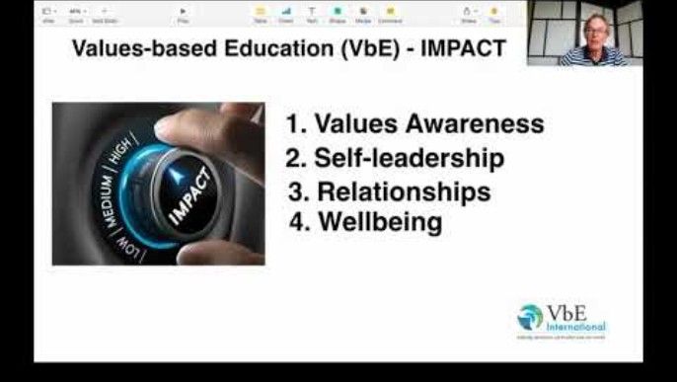
Values Based Education (VBE):
Education's Quiet Revolution - Neil Hawkes

Slide 6
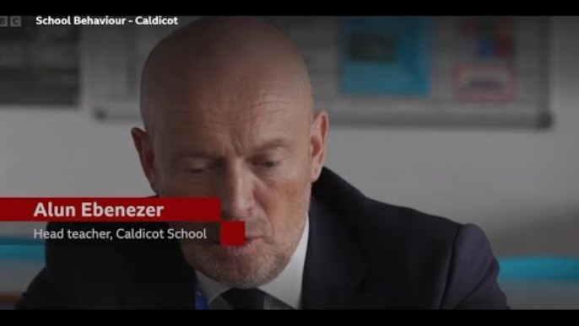
They let people like this lead schools…

Slide 7
The Inclusion Pledge
All who work with or on behalf of the children and young people of Barking and Dagenham undertake to promote and embed the following values of this Inclusion Pledge:
Schools provide safe people and spaces to support children’s rights and wellbeing. All children have the right to be safe, belong, achieve, be heard and contribute to their community.

Slide 8
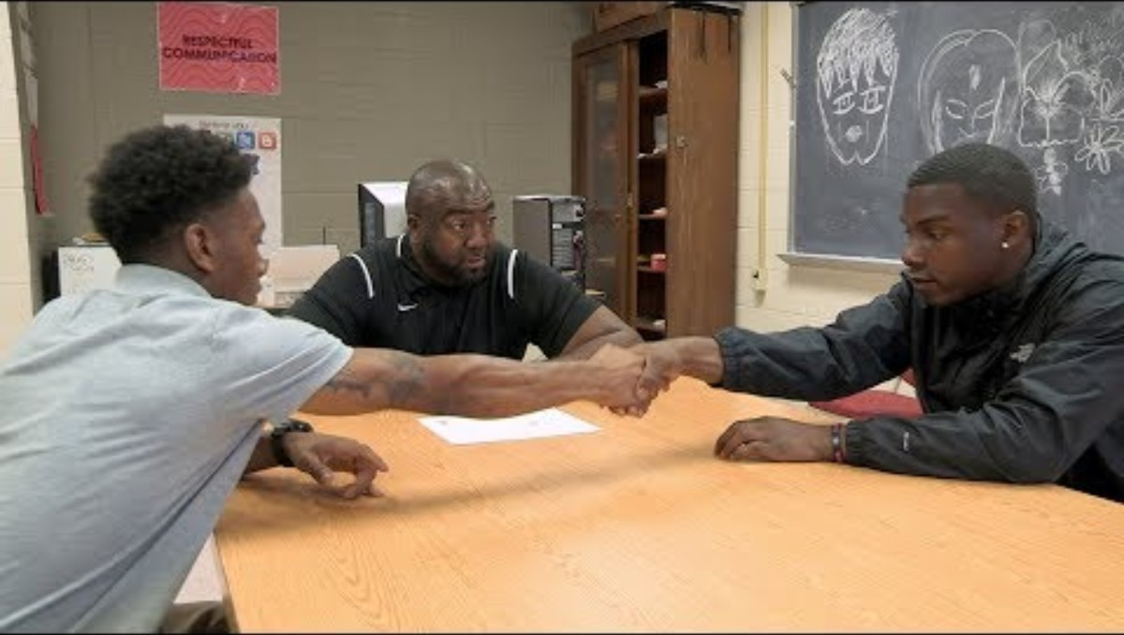
De-Escalation Spaces:
Helping Students Manage Emotions

Slide 9
The Inclusion Pledge
All who work with or on behalf of the children and young people of Barking and Dagenham undertake to promote and embed the following values of this Inclusion Pledge:
Behaviour is communication of a need and not a need in itself. Understanding behaviour is essential. Needs must be met in a compassionate and informed way.

Slide 10

If you only click on one hyperlink this year…
SEMH Handbook

Slide 11
The Inclusion Pledge
All who work with or on behalf of the children and young people of Barking and Dagenham undertake to promote and embed the following values of this Inclusion Pledge:
Language is a powerful means of communication and the way we use it directly impacts on the outcomes of our interactions. Respect for individual context, circumstances and needs means responding to individuals in a differentiated manner, seeking a positive outcome for each individual.

Slide 12
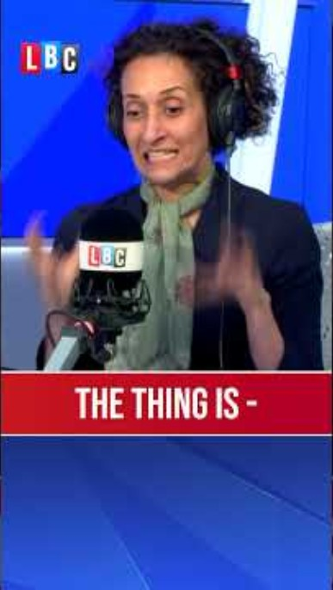
They let people like this lead schools…

Slide 13
“Cause I Ain’t Got a Pencil”
I woke myself up
Because we ain’t got an alarm clock
Dug in the dirty clothes basket,
Cause ain’t nobody washed my uniform
Brushed my hair and teeth in the dark,
Cause the lights ain’t on…
Even got my baby sister ready,
Cause my mama wasn’t home.
Got us both to school on time,
To eat us a good breakfast.
Then when I got to class the teacher fussed
Cause I ain’t got no pencil.
Joshua T Dickerson

Slide 14
The Inclusion Pledge
All who work with or on behalf of the children and young people of Barking and Dagenham undertake to promote and embed the following values of this Inclusion Pledge:
Nurture is central to the development of wellbeing, and young people need nurture and empathetic relationships alongside containment and structure.

Slide 15
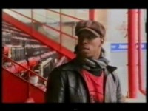
Ian Wright and Mr Pigden: Reunited Shock

Slide 16
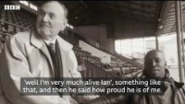
Ian Wright and Mr Pigden: Desert Island Discs

Slide 17
The Inclusion Pledge
All who work with or on behalf of the children and young people of Barking and Dagenham undertake to promote and embed the following values of this Inclusion Pledge:
Children and young people’s learning and wellbeing are understood developmentally. We believe in access to education that promotes equity, empathy, aspiration and success for all.

Slide 18
The Inclusion Pledge
All who work with or on behalf of the children and young people of Barking and Dagenham undertake to promote and embed the following values of this Inclusion Pledge:
Best quality communication between all professionals in all services is key to ensuring effective safeguarding and contextual safeguarding within both the school and the wider community. Engaging with and caring for the community around the child and the family.

Slide 19
The Inclusion Pledge
All who work with or on behalf of the children and young people of Barking and Dagenham undertake to promote and embed the following values of this Inclusion Pledge:
The importance of facilitating effective transitions at all relevant points in children’s and young people’s lives. We strive to bring about positive change and develop resilience for individuals, groups and families, and communities, built on an understanding of contexts as well as individual differences.

Slide 20
The Inclusion Pledge
All who work with or on behalf of the children and young people of Barking and Dagenham undertake to promote and embed the following values of this Inclusion Pledge:
A commitment to continually develop opportunities for our children and young people to realise their aspirations and ambitions within their own community. We value approaches to lifelong learning that draw on people’s potential and cultures that truly reflects the needs and aspirations of our community.

Slide 21
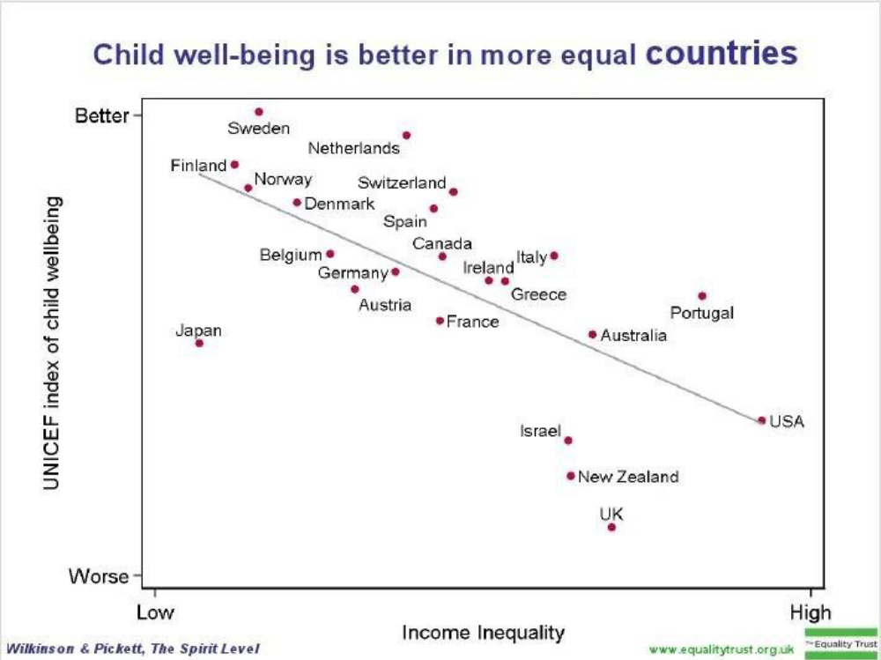

Slide 22
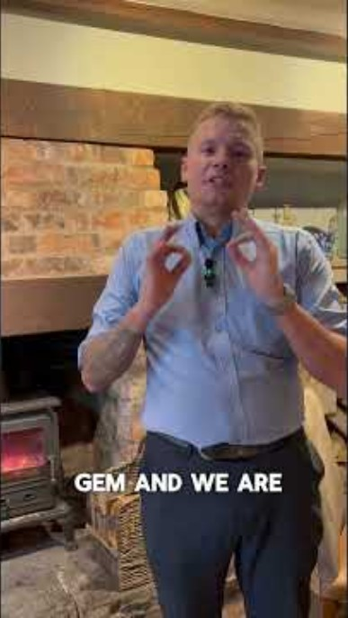
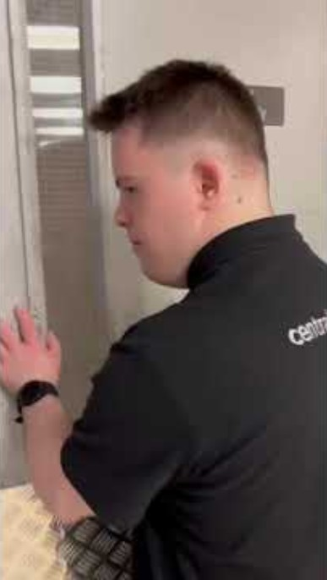
Supported Internships

